Slide 1


a
Know before you close.
The New Loan Estimate &
Closing Disclosure Explained
A look at the different sections of each new form and explanations of each page.
© 2015 Fidelity National Title Group

Slide 2

Five Things You Need to Know
Before August 2015
Know before you close.
© 2015 Fidelity National Title Group

Slide 3

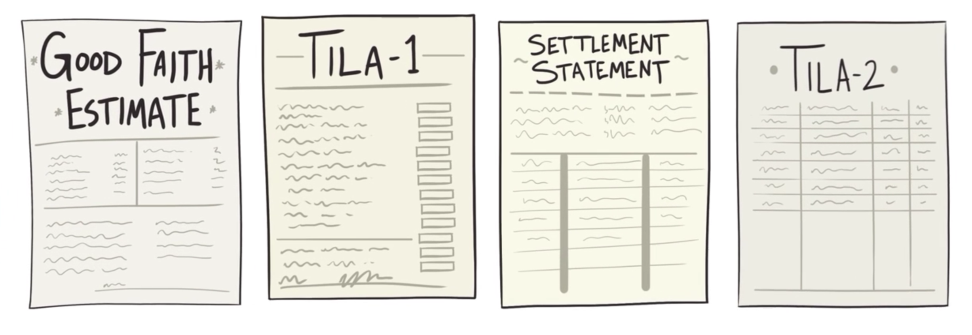
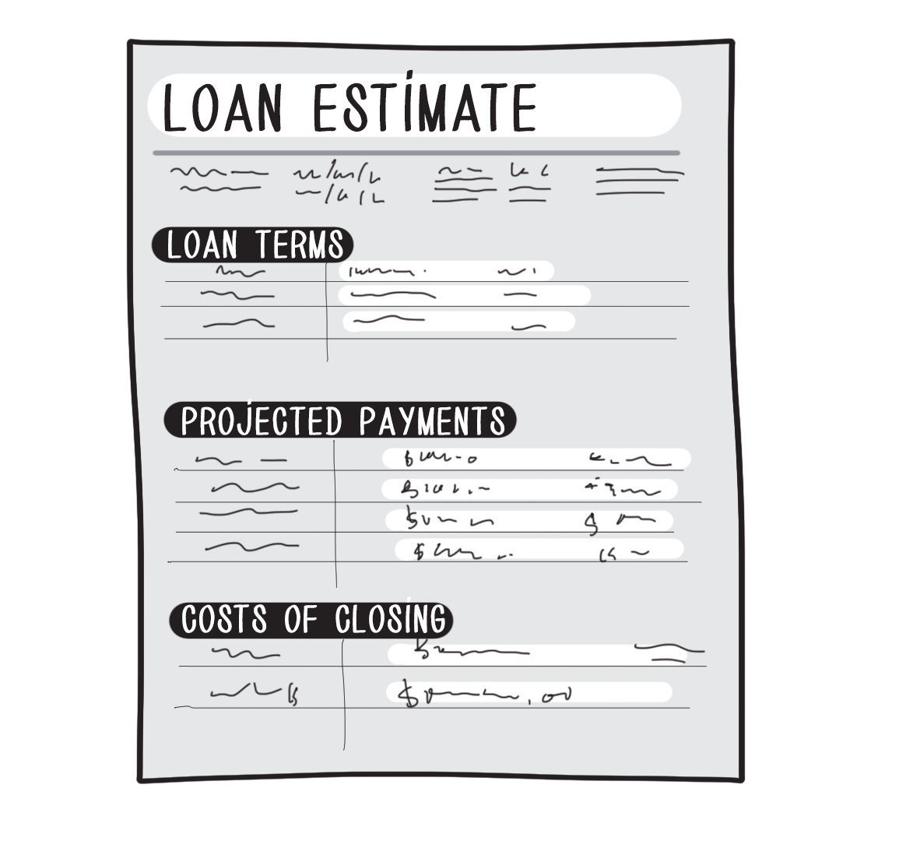
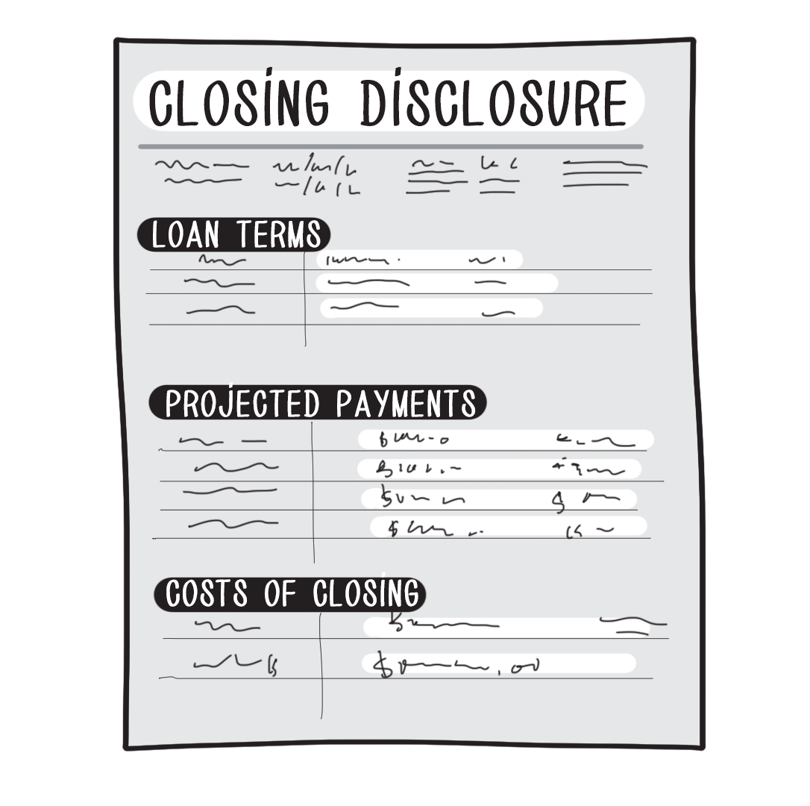
Know before you close.
© 2015 Fidelity National Title Group

Slide 4
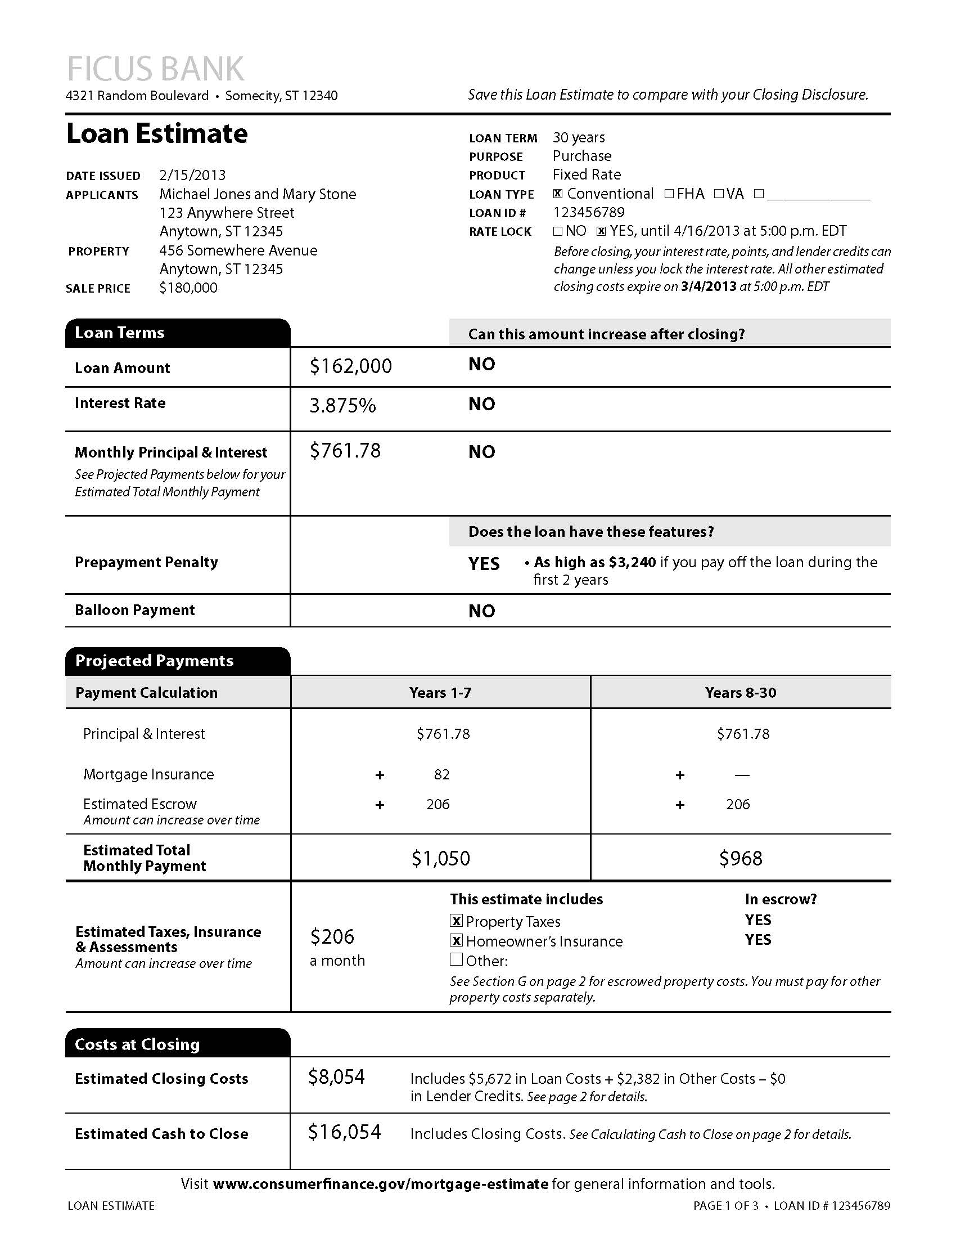
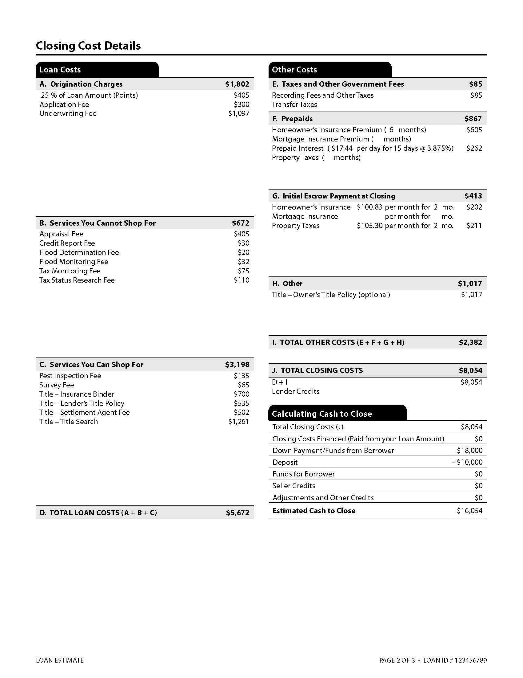
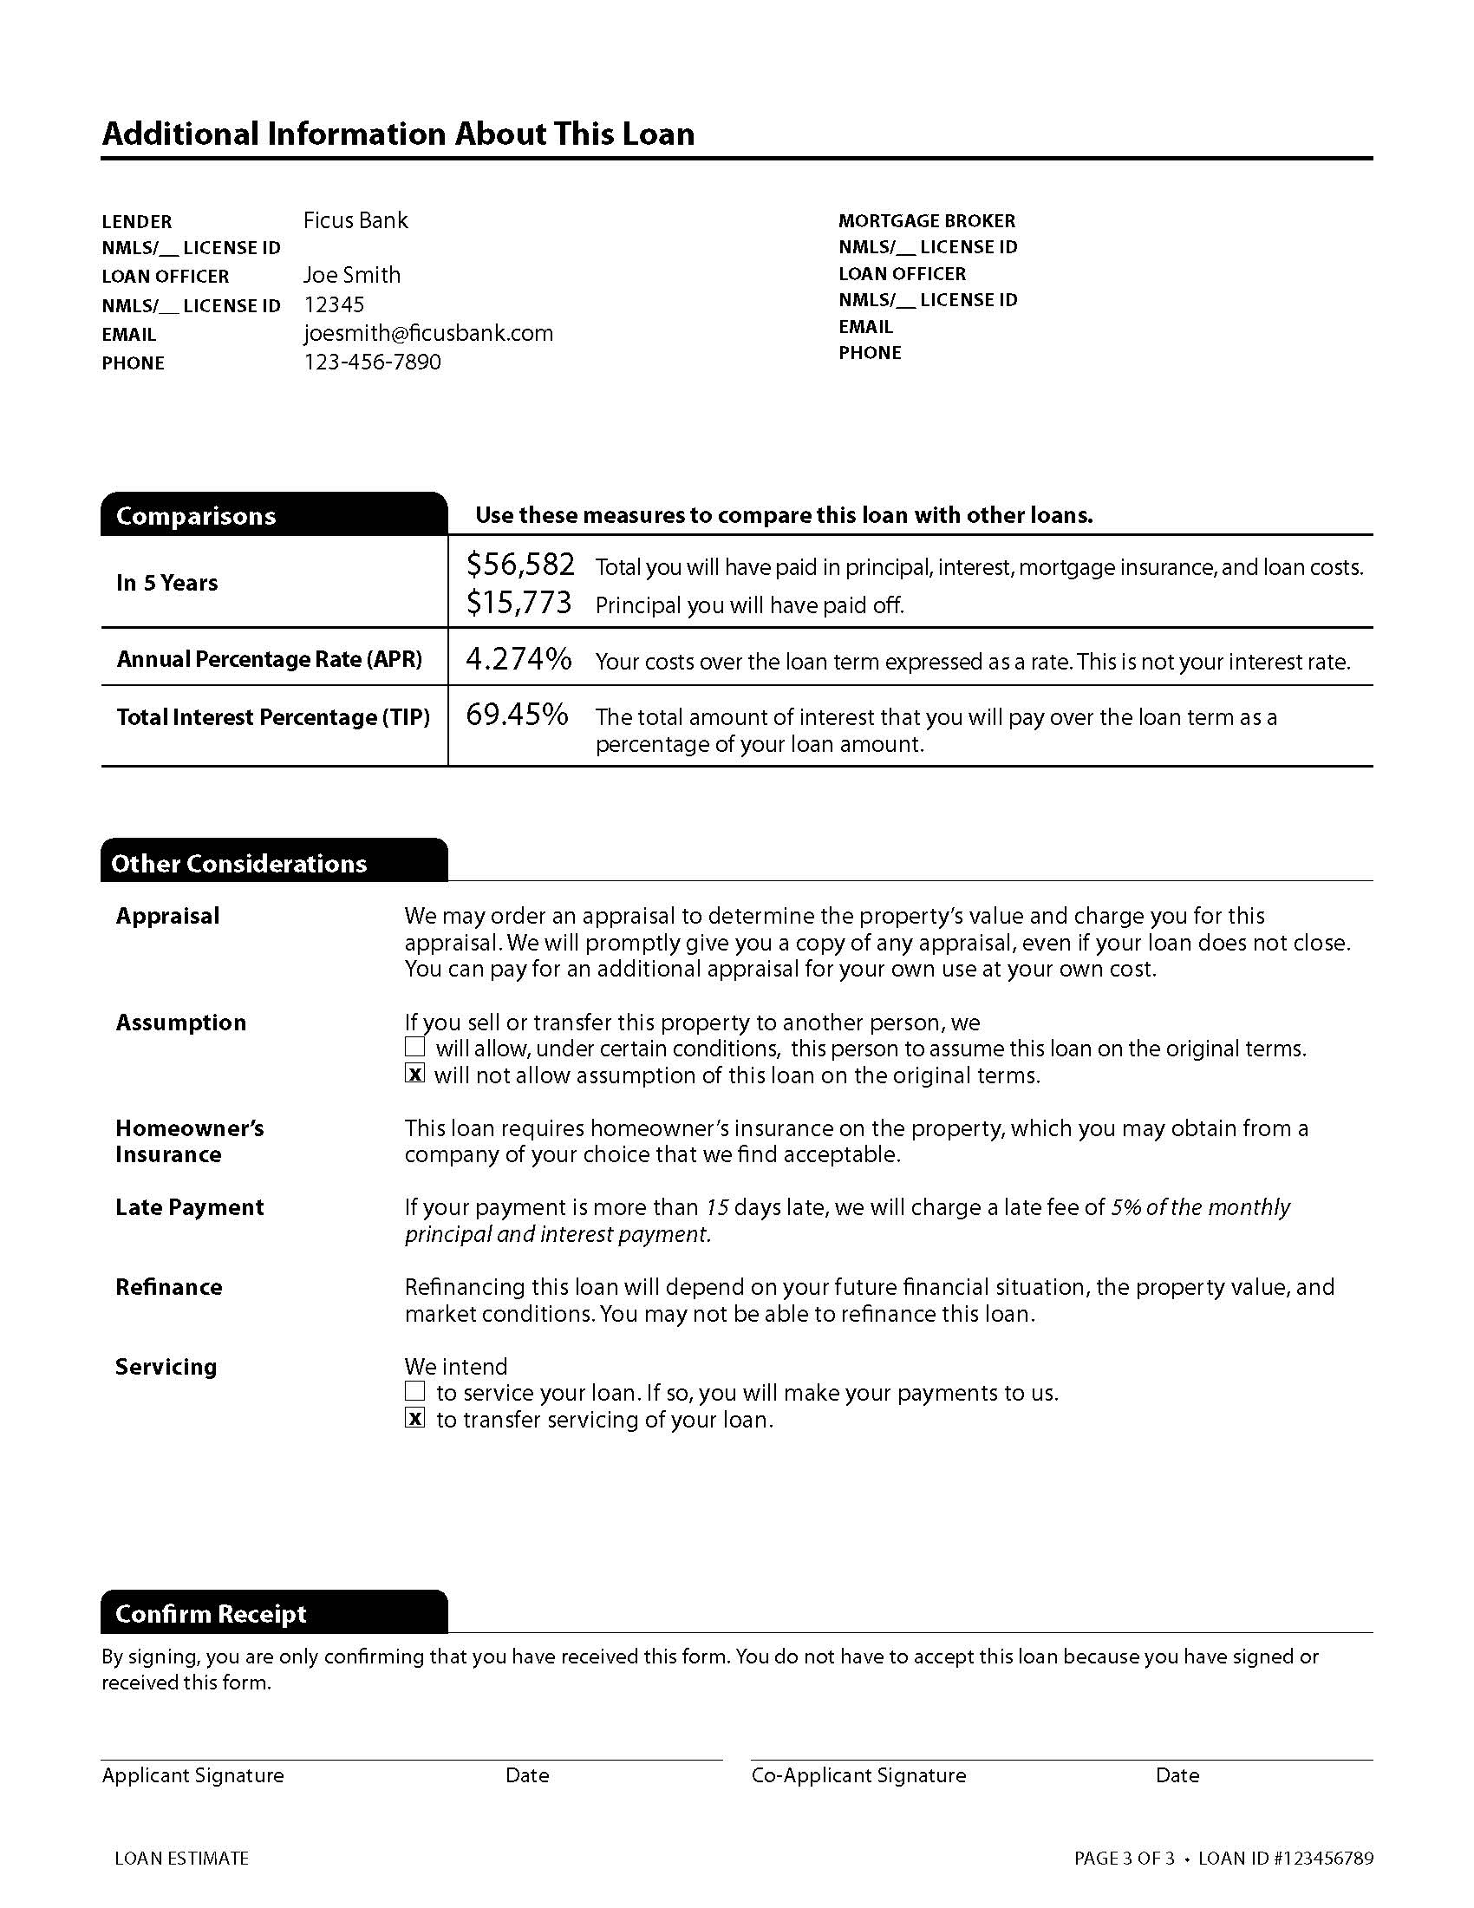
Know before you close.
^{Loan Estimate| At-a-Glance}
The new form is 3 pages long
New form replaces the GFE and Early TILA
The creditor is not allowed to revise and re-disclose if charges go up or down prior to the closing
Creditor errors are not legitimate reasons for revising Loan Estimates
© 2015 Fidelity National Title Group

Slide 5
^{Loan Estimate | pg.1}
Basic Information
Loan Terms
Projected Payments
Costs at Closing
© 2015 Fidelity National Title Group

Slide 6
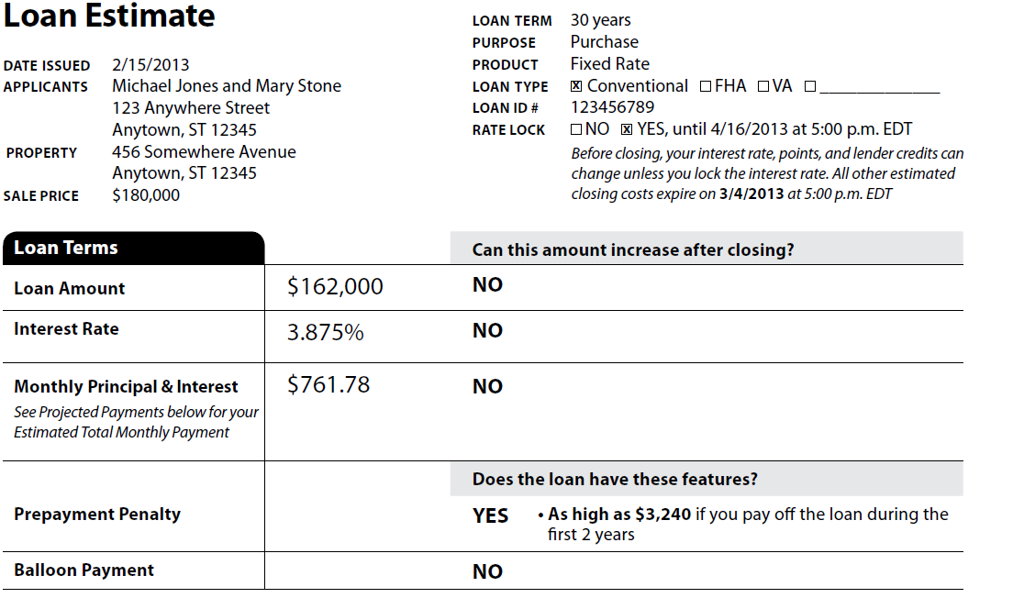
The Loan Estimate
Basic Transaction Information
Basic Loan Terms
© 2015 Fidelity National Title Group

Slide 7
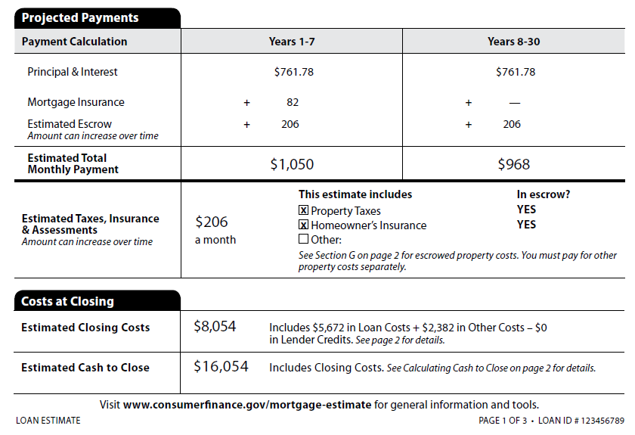
The Loan Estimate
Information about the New Monthly Mortgage Payment
Estimates amount borrower will need at closing

Slide 8
^{Loan Estimate | pg.2}
Loan Costs
Other Costs
Calculating Cash to Close
© 2015 Fidelity National Title Group

Slide 9
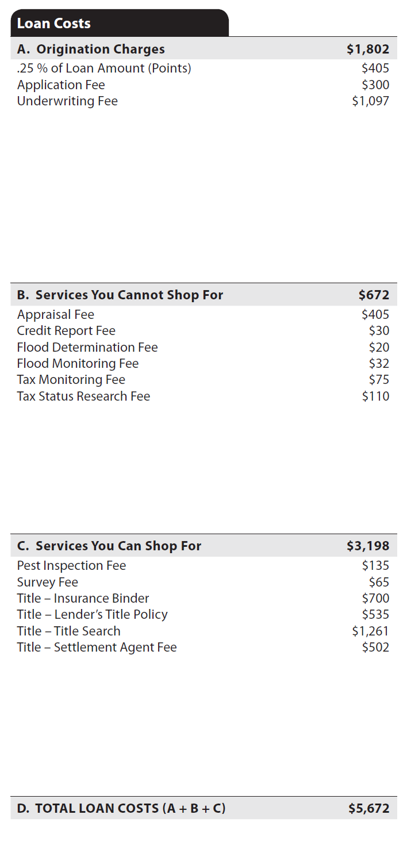
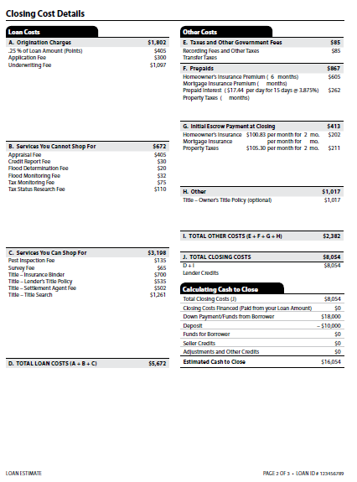
The Loan Estimate
Alphabetical Order
- Cost descriptions in each section must be listed in alphabetical order
Title Insurance and Settlement Charges
- The description of each fee related to title insurance or settlement (escrow) must be preceded by “Title –”
Lender’s Title Insurance – Purchase Transactions
- Must show the full Loan Policy Rate, NOT the simultaneous issue rate often charged when an Owner’s policy is also issued
© 2015 Fidelity National Title Group

Slide 10
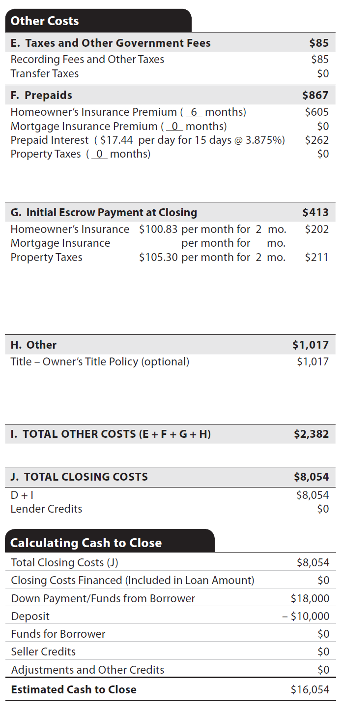
The Loan Estimate
Owner’s Title Insurance Rules
If to be paid by borrower, must show “(optional)” in description
Actual Charge not shown - for simultaneous issue, owner’s rate = Owner’s Rate + Simultaneous Issue Loan rate – Full Loan rate
© 2015 Fidelity National Title Group

Slide 11
^{Loan Estimate | pg.3}
Comparisons
Other Considerations
Confirm Receipt
© 2015 Fidelity National Title Group

Slide 12
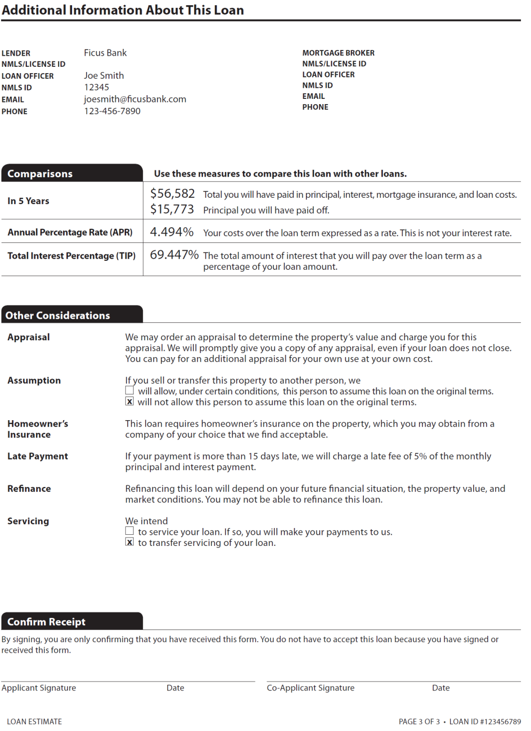
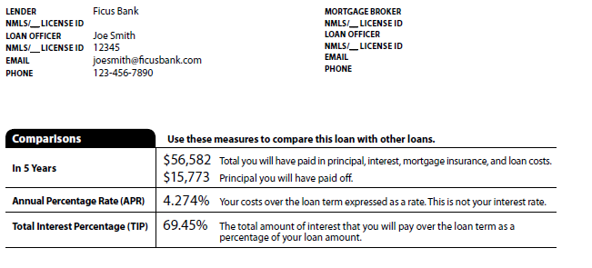
The Loan Estimate
Various specific Loan calculations, including APR, required under TILA, RESPA or Dodd-Frank

Slide 13
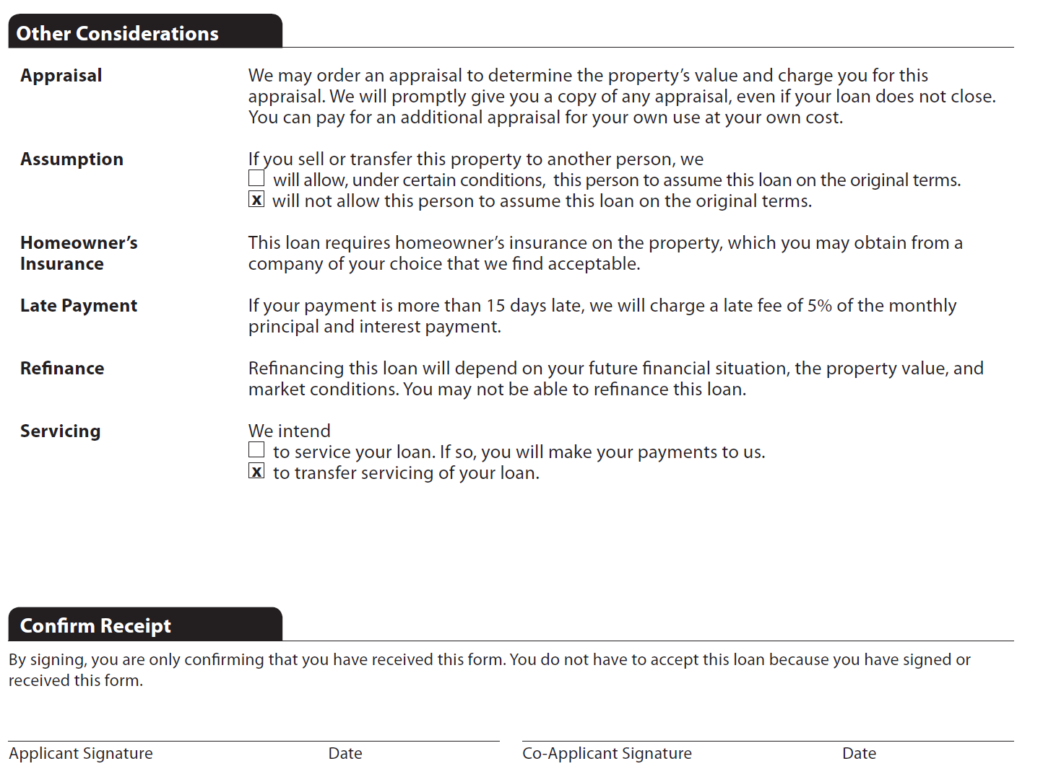
The Loan Estimate

Slide 14
The Loan Estimate
^{Receiving the Loan Estimate}
Lender must deliver within three business days of the lender’s receipt of an “application”
Application – automatically occurs when lender receives six pieces of information:
    Borrower(s) Name(s)
    Income
    Social Security Number(s)
    Property Address
    Estimated Value of Property
    Mortgage Loan Amount
© 2015 Fidelity National Title Group

Slide 15
The Loan Estimate
^{Receiving the Loan Estimate}
Except for credit report, no fees chargeable until after Loan Estimate is provided
Lender must attach separate Provider List similar to that currently used with the GFE
  Must include all services which the borrower may need for the transaction (not just items for loan)
© 2015 Fidelity National Title Group

Slide 16
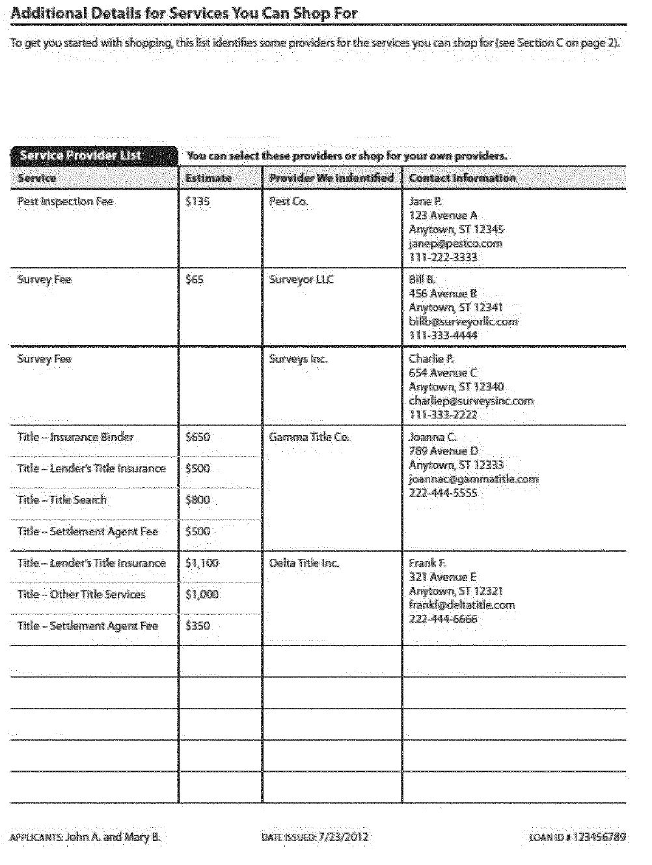
The Loan Estimate
^{The Provider List}

Slide 17
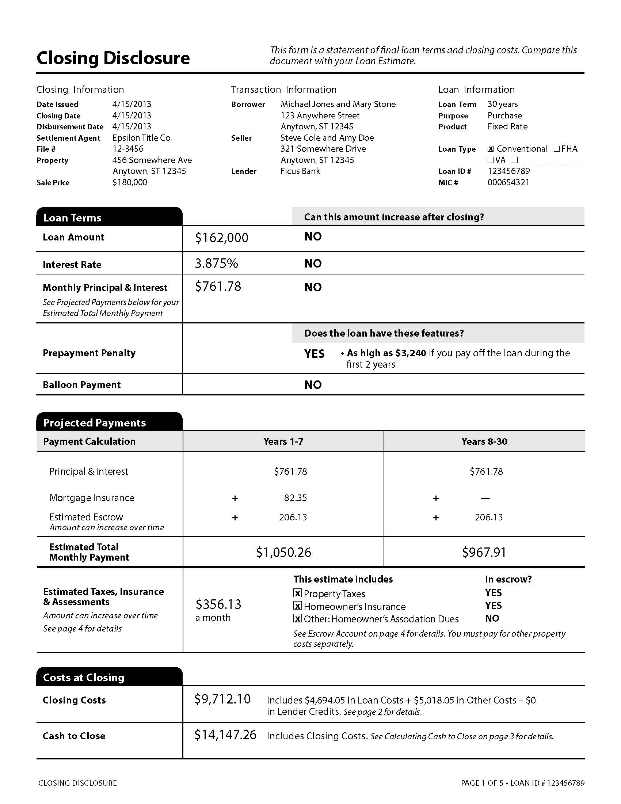
Know before you close.
Closing Disclosure | At-a-Glance
The new form is 5 pages long
New form replaces the TILA and HUD-1
One closing disclosure is required for each loan
Charge descriptions on both the loan estimate and closing disclosure must match
© 2015 Fidelity National Title Group

Slide 18
Closing Disclosure| pg.1
Basic Information
Loan Terms
Projected Payments
Costs at Closing
© 2015 Fidelity National Title Group

Slide 19
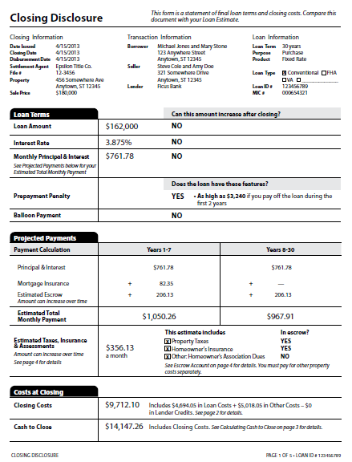
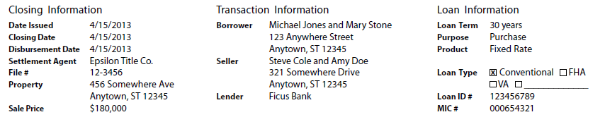
Close Disclosure
Closing Disclosure| pg.1
Basic Transaction Information

Slide 20
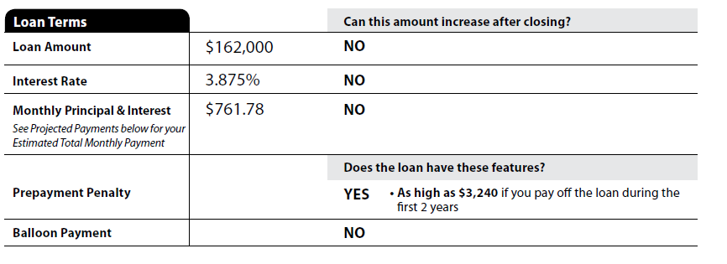
Close Disclosure
Closing Disclosure| pg.1
Description of Basic Loan Terms

Slide 21
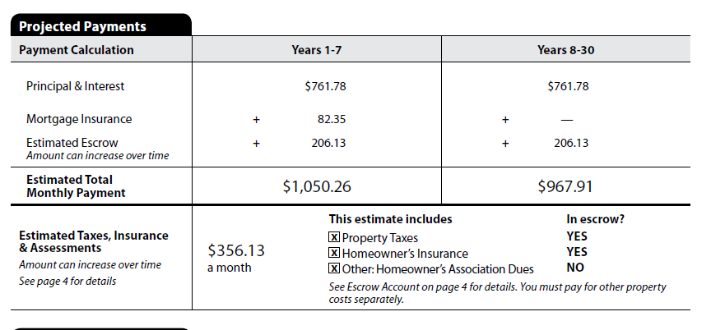
Closing Disclosure| pg.1
Information about the New Monthly Mortgage Payment
Amount includes monthly obligations on property even if not included in impound amount

Slide 22
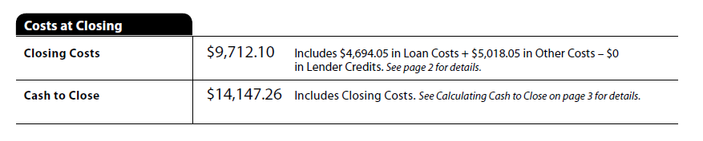
Closing Disclosure| pg.1
Cash to Close – shows the buyer/borrower the amount necessary for closing

Slide 23
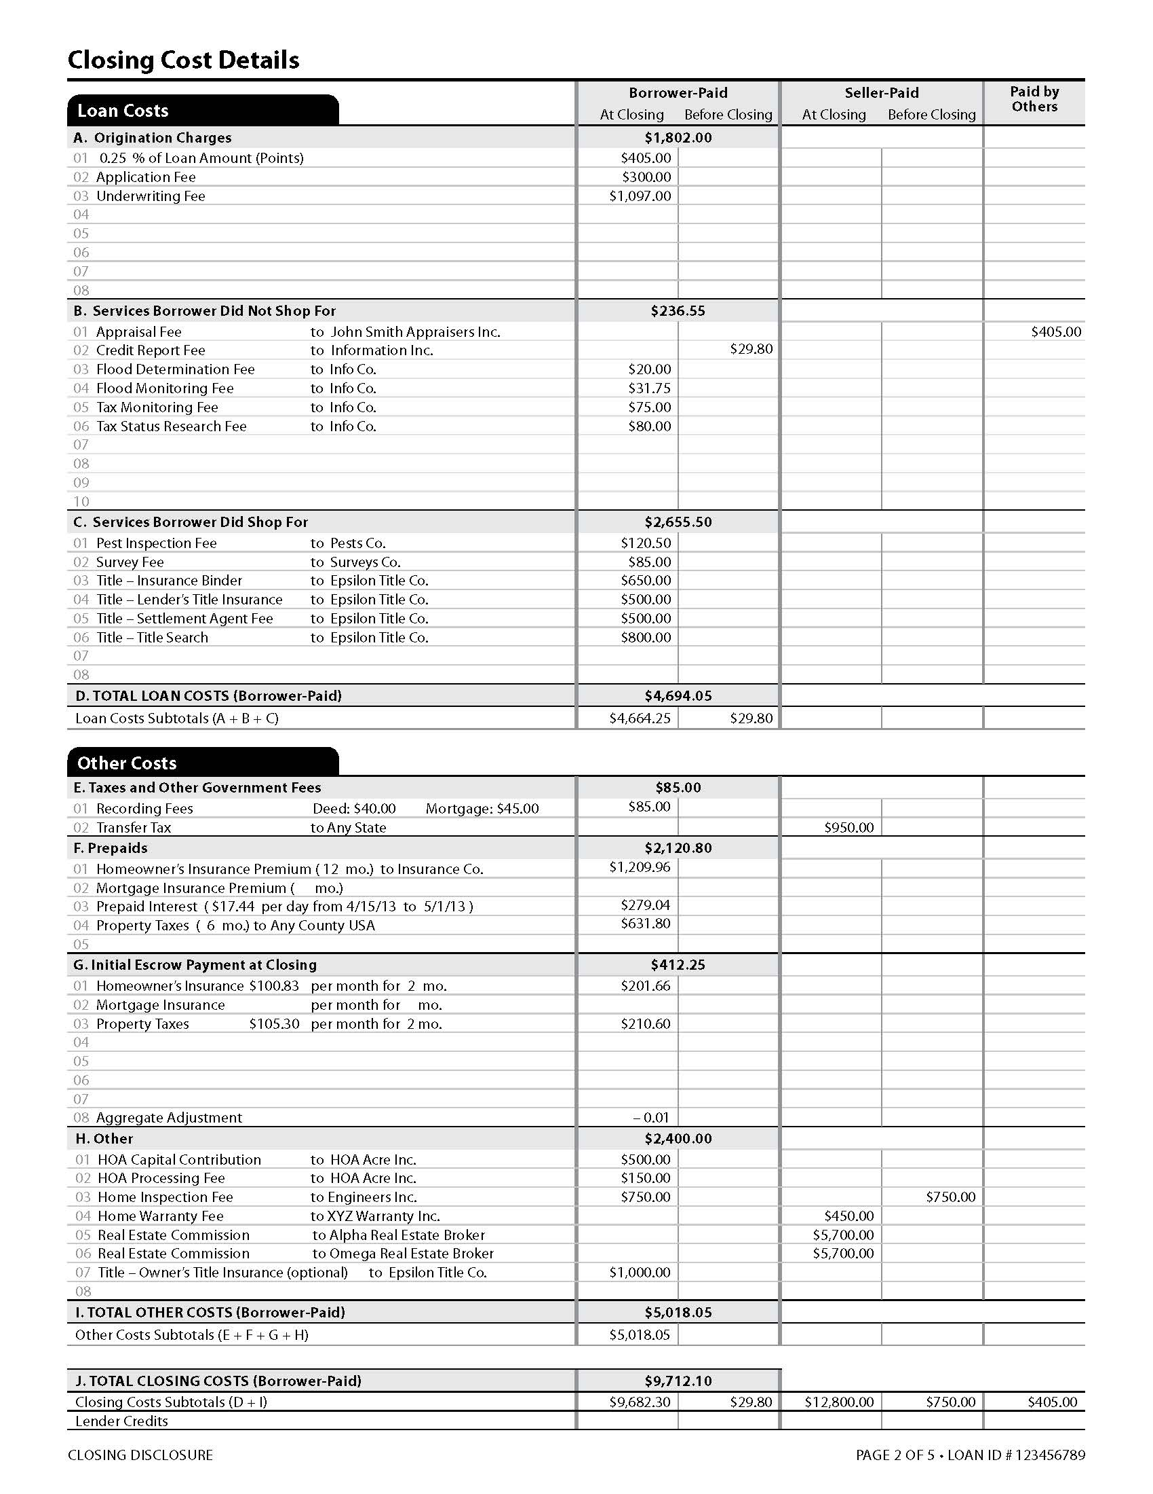
Closing Disclosure| pg.2
Loan Costs
Other Costs
© 2015 Fidelity National Title Group

Slide 24
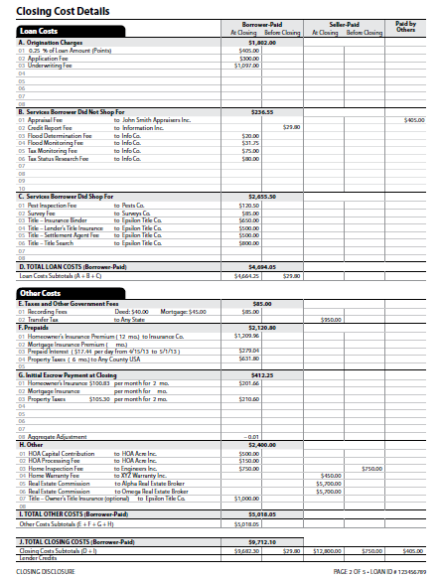
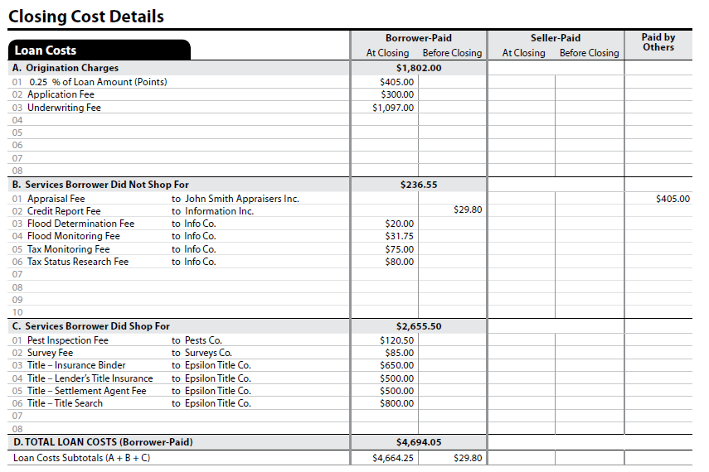
Closing Disclosure| pg.2
Cost Descriptions
Must be substantially similar to description on Loan Estimate
Alphabetical Order
“Title –” designation on all Title and Settlement Fees
Lender’s Title Rule
24

Slide 25
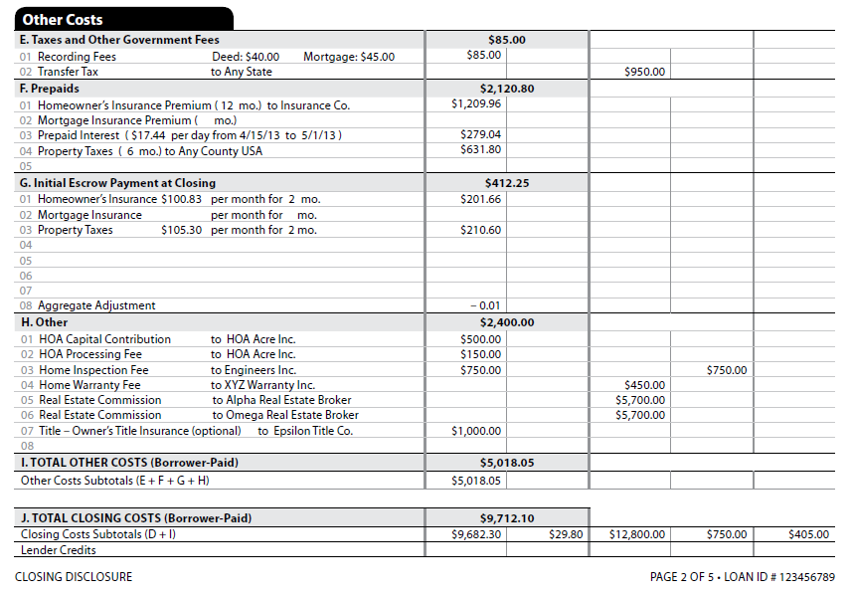
Closing Disclosure| pg.2
Owner’s Title Rule
© 2015 Fidelity National Title Group

Slide 26
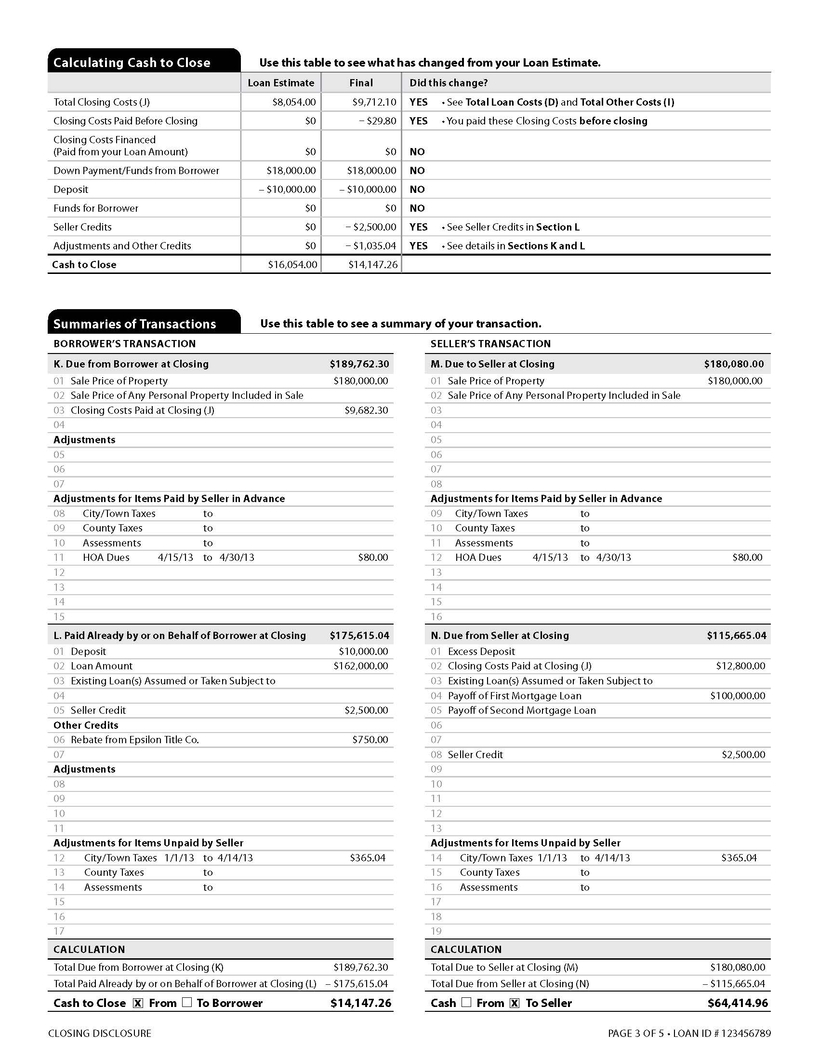
Closing Disclosure| pg.3
Calculating Cash to Close
Summaries of Transactions
© 2015 Fidelity National Title Group

Slide 27
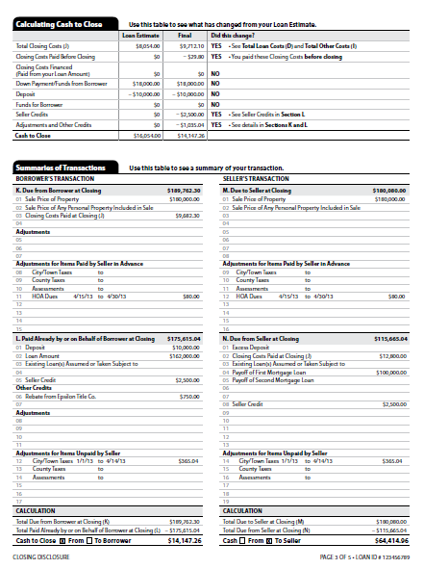
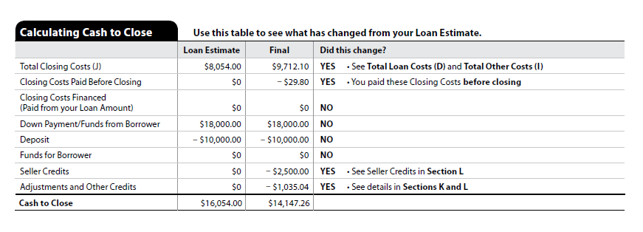
Closing Disclosure| pg.3
Comparison Table – shows the buyer/borrower a comparison of amounts from Loan Estimate v. Closing Disclosure

Slide 28
Closing Disclosure| pg.3
Summary of Transactions –
a summary of the transaction similar to page 1 of the HUD-1 Settlement form
© 2015 Fidelity National Title Group
28

Slide 29
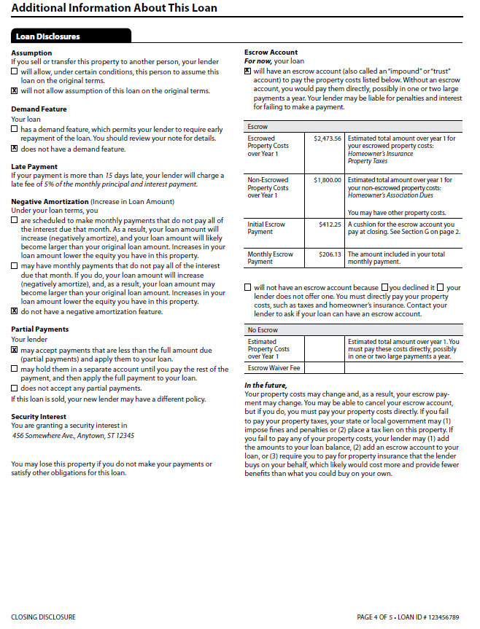
Closing Disclosure| pg.4
Loan Disclosures –
contains various lender disclosures required under TILA, RESPA or Dodd-Frank
© 2015 Fidelity National Title Group

Slide 30
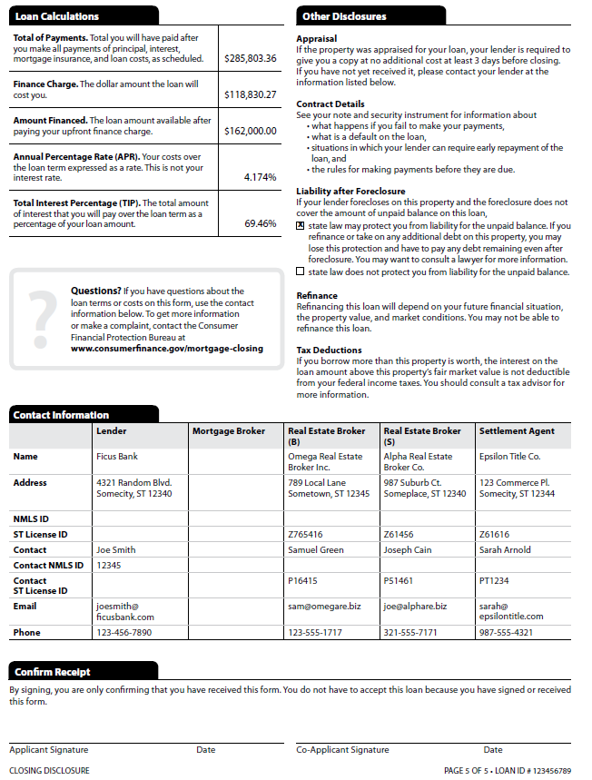
Closing Disclosure| pg.5
Loan Calculations –
Various specific Loan calculations, including Finance Charge and APR, required under TILA, RESPA or Dodd-Frank
Other Disclosures –
Various lender disclosures required under TILA, RESPA or Dodd-Frank
Contact Information –
Confirm Receipt –
© 2015 Fidelity National Title Group

Slide 31
Closing Disclosure
Who prepares the new Closing Disclosure Form?
The Lender is primarily responsible for the preparation and delivery of the Closing Disclosure
The Lender may permit the Settlement agent some portions or all of the form and/or deliver the form
  Settlement Agent liability – for those portions prepared or delivered
  Lender remains responsible for all portions of the Closing Disclosure to “ensure the disclosures are provided” in accordance with the rule
© 2015 Fidelity National Title Group

Slide 32
Closing Disclosure
Three different three-day periods in closing
The 3-day right of rescission (“3-day rescission”) under TILA
  Presently applicable to most refinance transactions
  Not impacted by the Final Rule
The 3-day waiting period (“3-day waiting”) after delivery of the Closing Disclosure, the Borrower has 3 days to review before a closing may occur
The 3-day delivery period for delivery of the Closing Disclosure (“3-day delivery”) –
  Unless the Closing Disclosure is delivered personally, the Rule “deems” it delivered three business days later
  Period may be shortened by actual confirmation of receipt
© 2015 Fidelity National Title Group

Slide 33
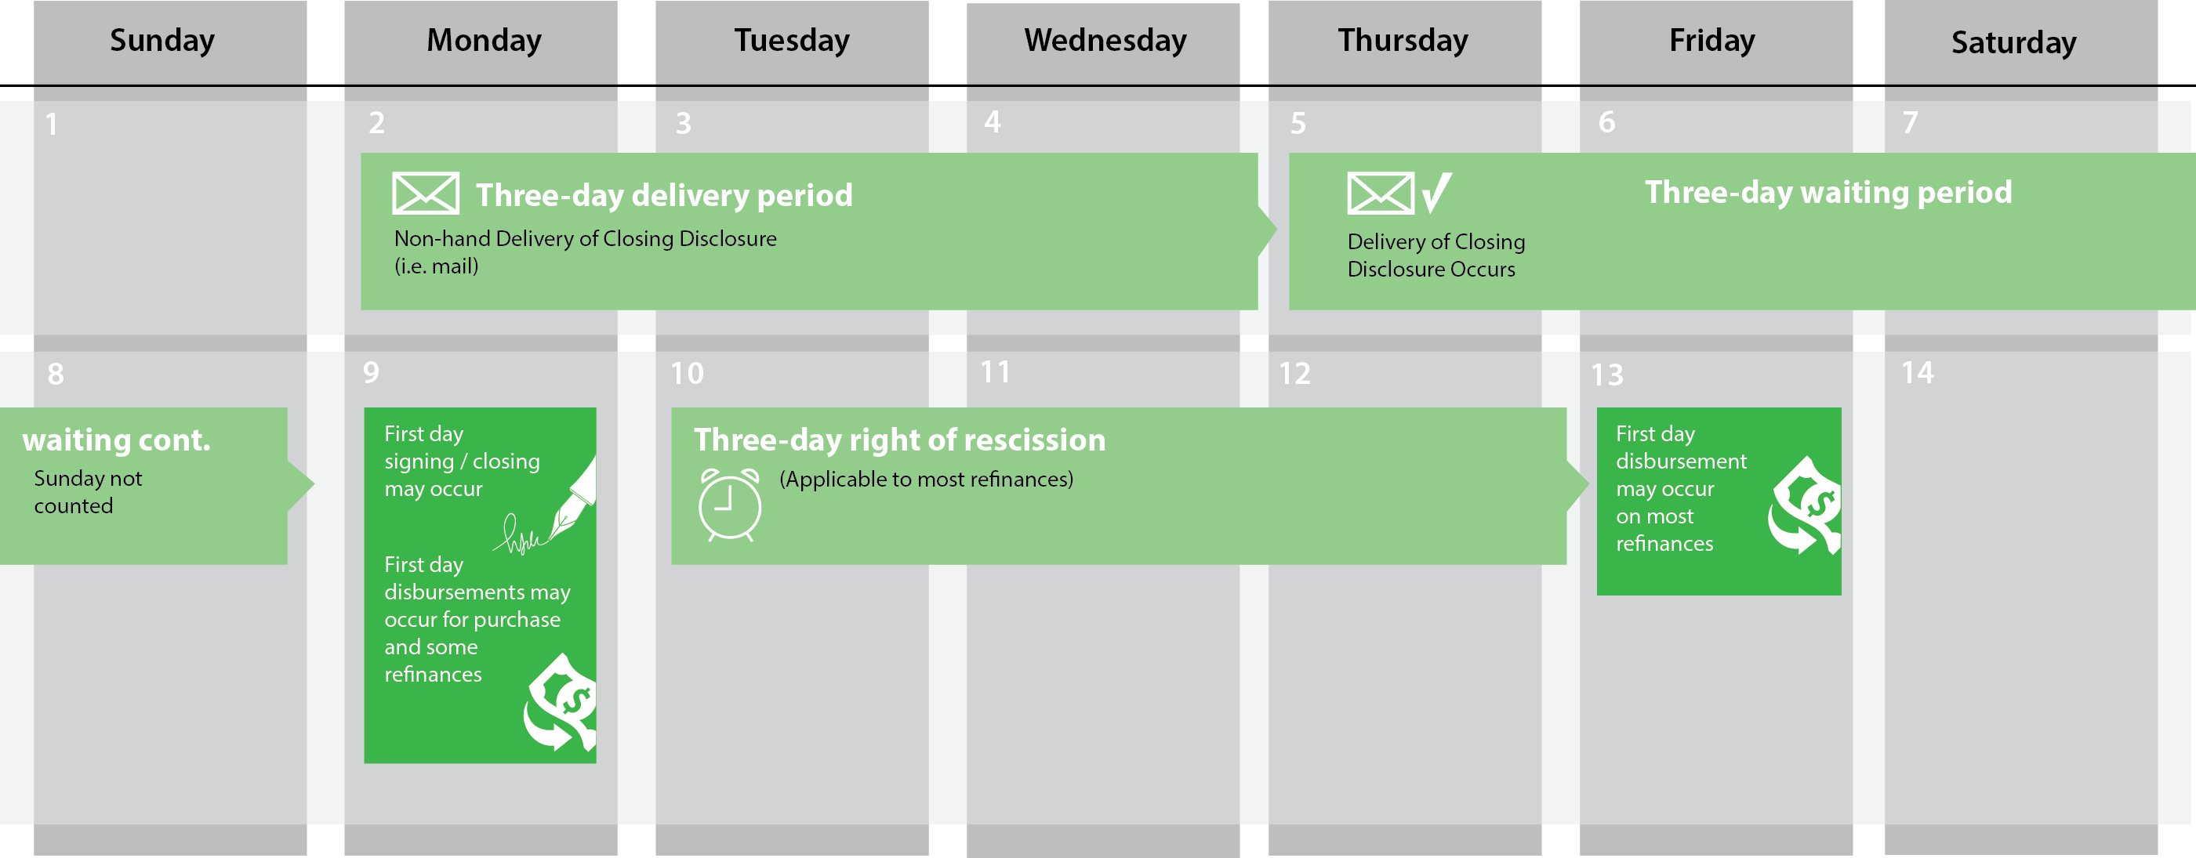
Closing Disclosure
Disclosure Delivery Timing
© 2015 Fidelity National Title Group

Slide 34
Closing Disclosure
Changes to initial Closing Disclosure after delivery
Only a few changes will require another 3-day waiting period –
Change in the loan program
Example – moving from fixed rate to an adjustable rate loan
Changes to Annual Percentage Rate (APR) greater than 1/8 %
Applies only to increases in APR items , other increases do not trigger a new disclosure with waiting period.
Caution – other increases may still cause tolerance violations
The addition of a prepayment penalty fee after the initial disclosure But , all changes require a new Closing Disclosure to be prepared and delivered at or before “consummation”.
© 2015 Fidelity National Title Group

Slide 35
Closing Disclosure
Closing Disclosure to the Seller
Settlement Agent is responsible for providing the Closing Disclosure to the Seller
Closing Disclosure format for the seller may be either:
  The same format as for Borrower, but items related solely to borrower (i.e., loan disclosures) and using only seller data; or
  Use the separate CFPB seller’s disclosure form
  Disclosure must be delivered to the Seller on or before “consummation”; no 3-day waiting period
  3-business day delivery period applies, except for personal delivery.
© 2015 Fidelity National Title Group

Slide 36
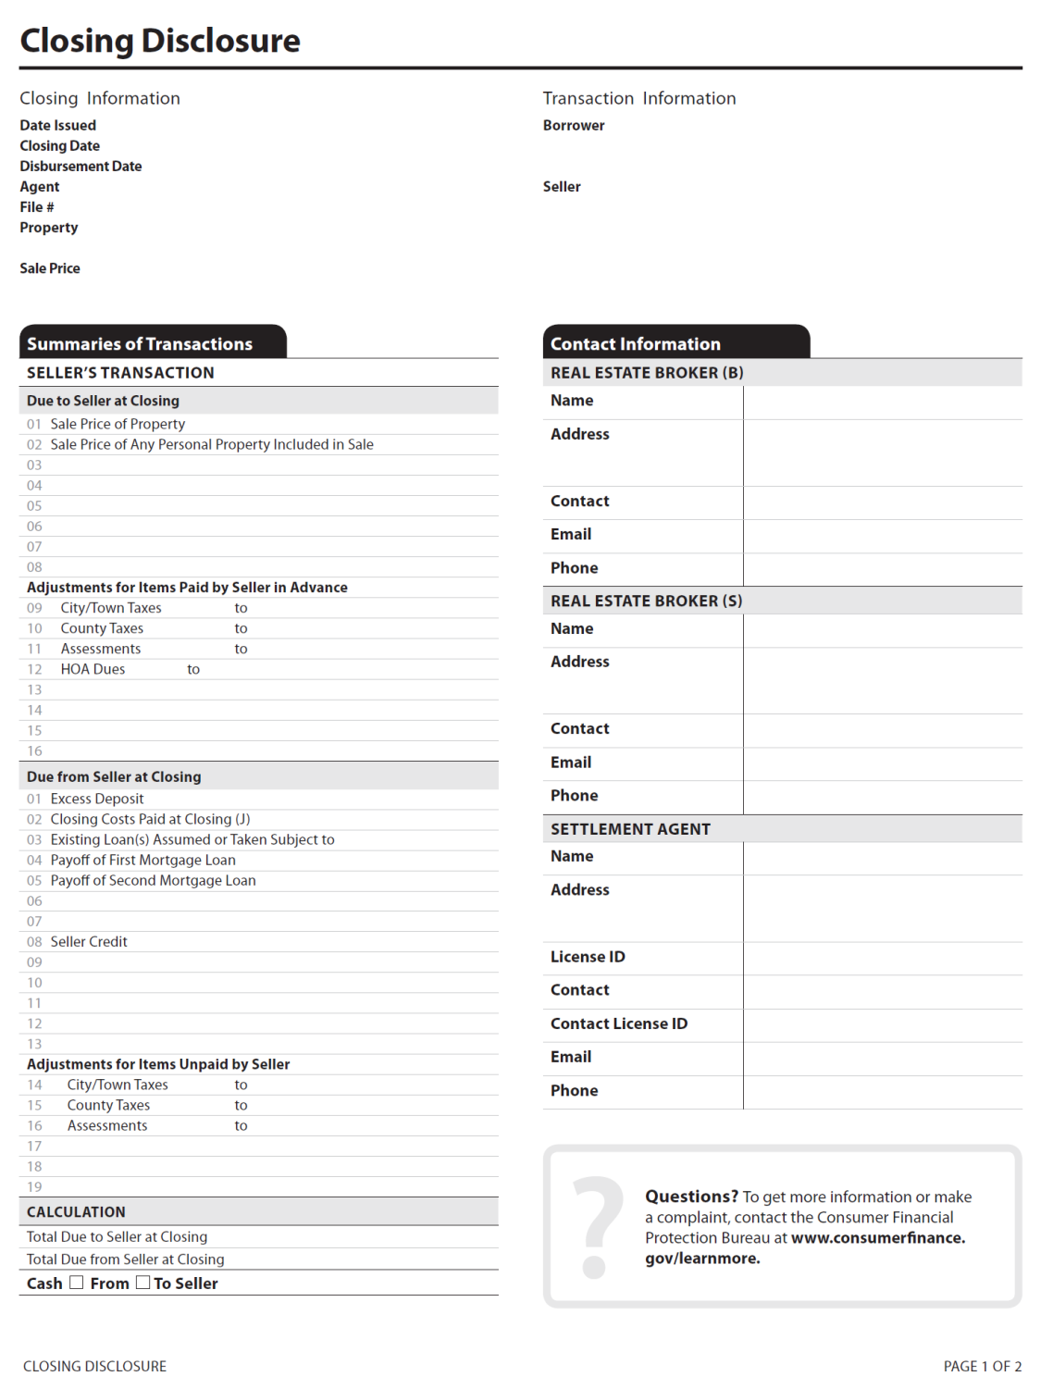
Seller’s Disclosure

Slide 37
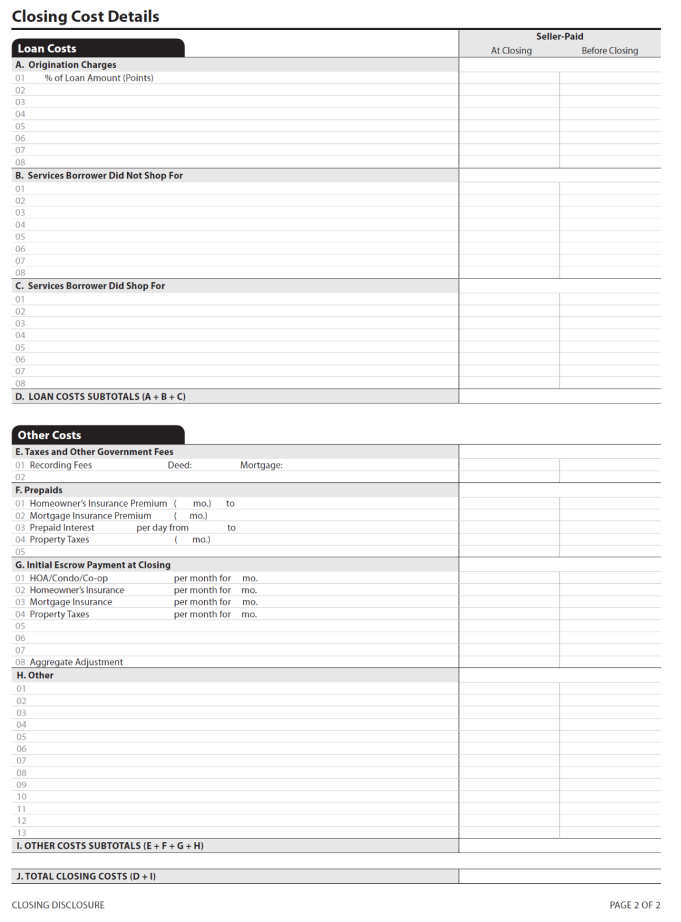
Seller’s Disclosure

Slide 38
Closing Disclosure
Tolerance Rule Changes
Both TILA and RESPA previously contained tolerance rules:
  TILA rules generally required a re-disclosure if finance charges or APR exceeded threshold
  RESPA actually provided penalties (“tolerance violations”) if an item, or series of items, exceeded a monetary threshold
© 2015 Fidelity National Title Group

Slide 39
Closing Disclosure
Tolerance Rule Changes
Changes to tolerance rules
  Addition to “zero tolerance” category (may not change for numbers on Loan Estimate)
  Third Party Services where the provider is selected by the Lender
  Third Party Services provided by an affiliate of the Lender
© 2015 Fidelity National Title Group

Slide 40
Closing Disclosure
Other Rule Provisions
Certain Non-RESPA Loans Now Covered – new disclosure forms will now be used for these loans
  Vacant Land Loans
  Construction-Only loans
  “25+ -Acre” Loans
© 2015 Fidelity National Title Group

Slide 41
Closing Disclosure
Other Rule Provisions
RESPA Loans Not Covered in Future – these loan will NOT be documented with the new forms
  Reverse mortgages
  Institutions originating 5 or fewer loans per year
  Loans will be documented using existing GFE and HUD-1 forms and rules
  Software systems (and personnel) must be able to operate in both environments and recognize the differences
© 2015 Fidelity National Title Group

Slide 42
Know before you close.
Question?
© 2015 Fidelity National Title Group

Slide 43
a
Know before you close.
The New Loan Estimate &
Closing Disclosure Explained
A look at the different sections of each new form and explanations of each page.
© 2015 Fidelity National Title Group

